Slide 1
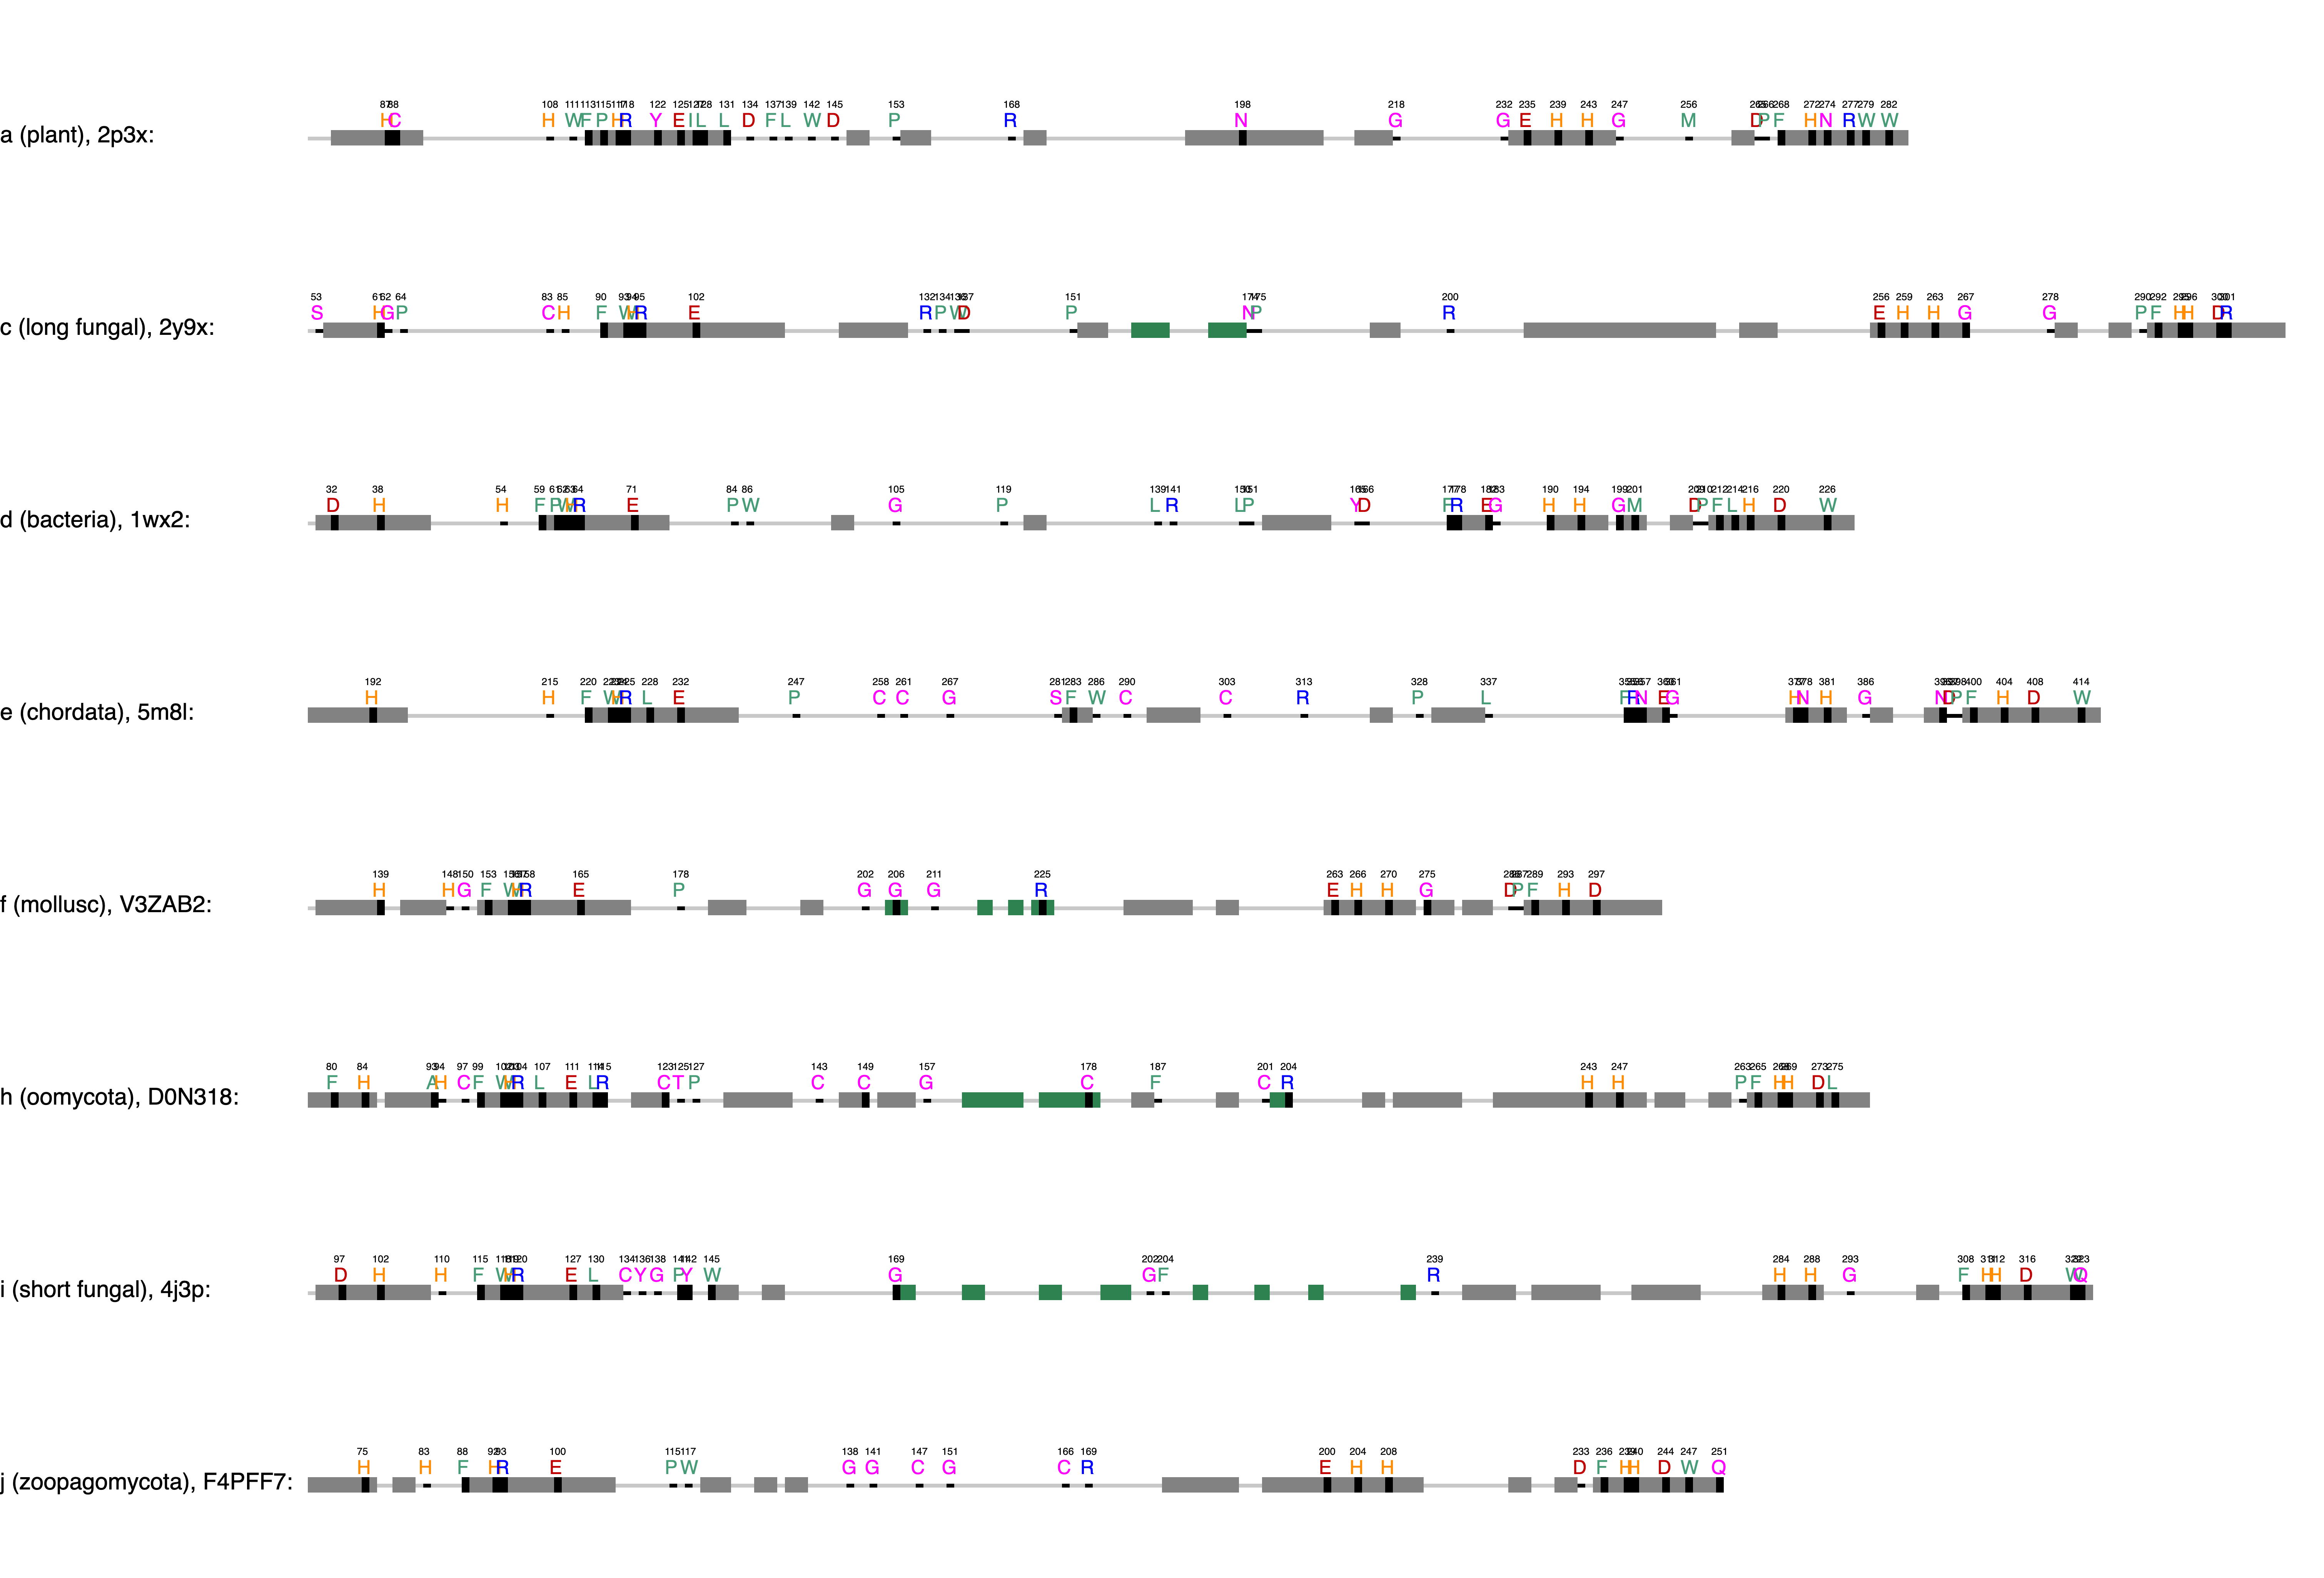
CuA binding motif
CuB binding motif
ppovv
+84
Gatekeeper, F259, 68%, Kampatsikas
Thioether
+62
Blocker residue, Kanteev
+32
+202
+130
First activity controller (HisB₁+1), Kampatsikas
+77
aoco4
+93
+68
The seventh His (HisB₃-1), Kampatsikas

Slide 2
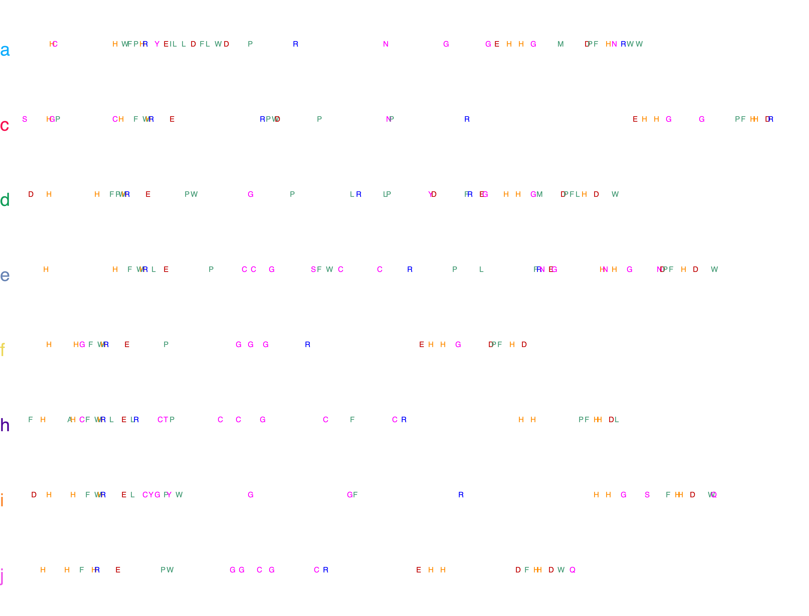
Cu_{A} binding motif
Cu_{B} binding motif

Slide 3
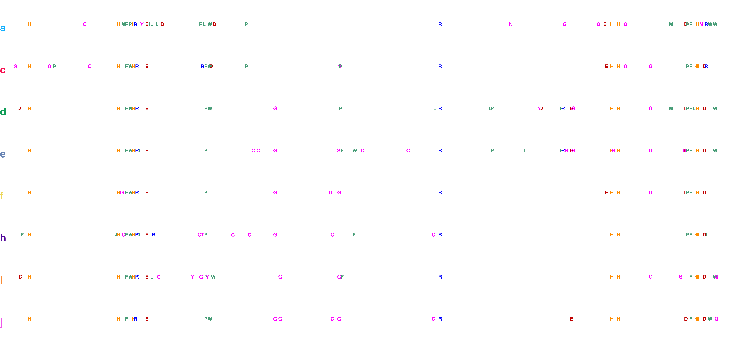
Cu_{A} binding motif
Cu_{B} binding motif

Slide 5
a
Monophenolase
(Monooxygenase)
Diphenolase
(2e⁻ oxidation)
b
Coupled binuclear copper (CBC) proteins
Hemocyanins
Polyphenol oxidases
O₂ transportation
Tyrosinases
Catechol oxidases
O-Aminophenol oxidases
”O-methoxy phenolases”
Guaicyl
Syringyl

Slide 6
Monophenolase
(Monooxygenase)
Diphenolase
(2e⁻ oxidation)

Slide 8
i₁
x
i₂
i₃
i₄
i₅
x
x
Not active on S-type monophenols
Not tested on S-type monophenols

Slide 9
Hydroxylation
Gauiacol
Demethoxylation and hydroxylation
Methoxy-ortho-diphenol
Syringol

Slide 10
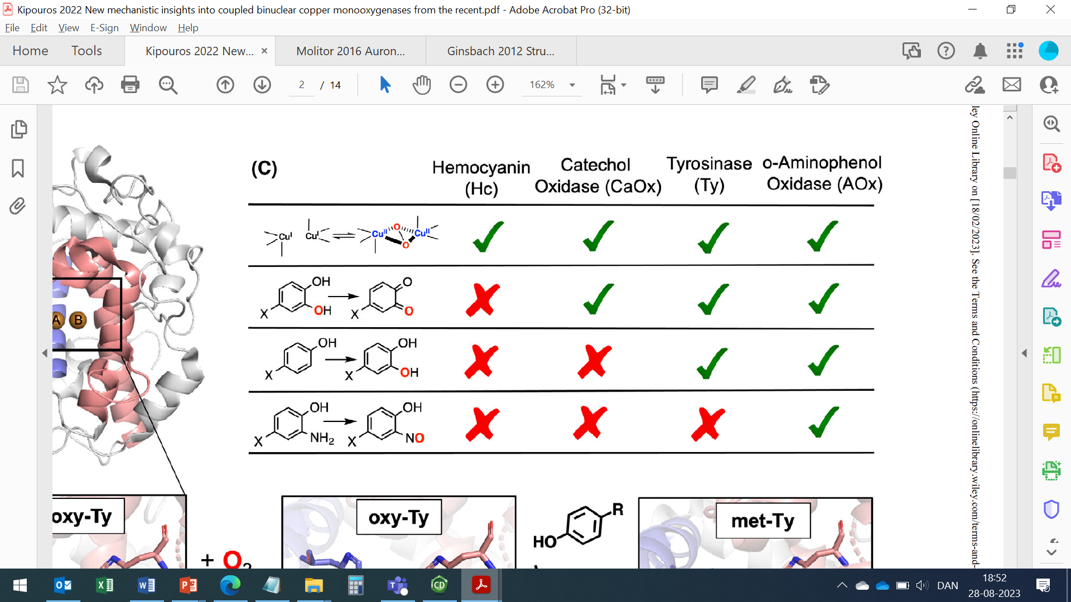
a
EC 1.14.18.1
EC 1.10.3.1
EC 1.10.3.4
b
Monophenolase
AbPPO3
P-Coumaroyl unit (H)
Monophenolase
MtPPO7, MtPPO-809,
MtPPO-010, CgPPO-473,
CgPPO-266, PpPPO-c2092
Guaiacyl unit (G)
Monophenolase + demethoxylation
MtPPO7, CgPPO-1473,
CgPPO-266
Syringyl unit (S)

Slide 11
Guaicyl
Syrringyl
Guaicyl
Syrringyl

Slide 12
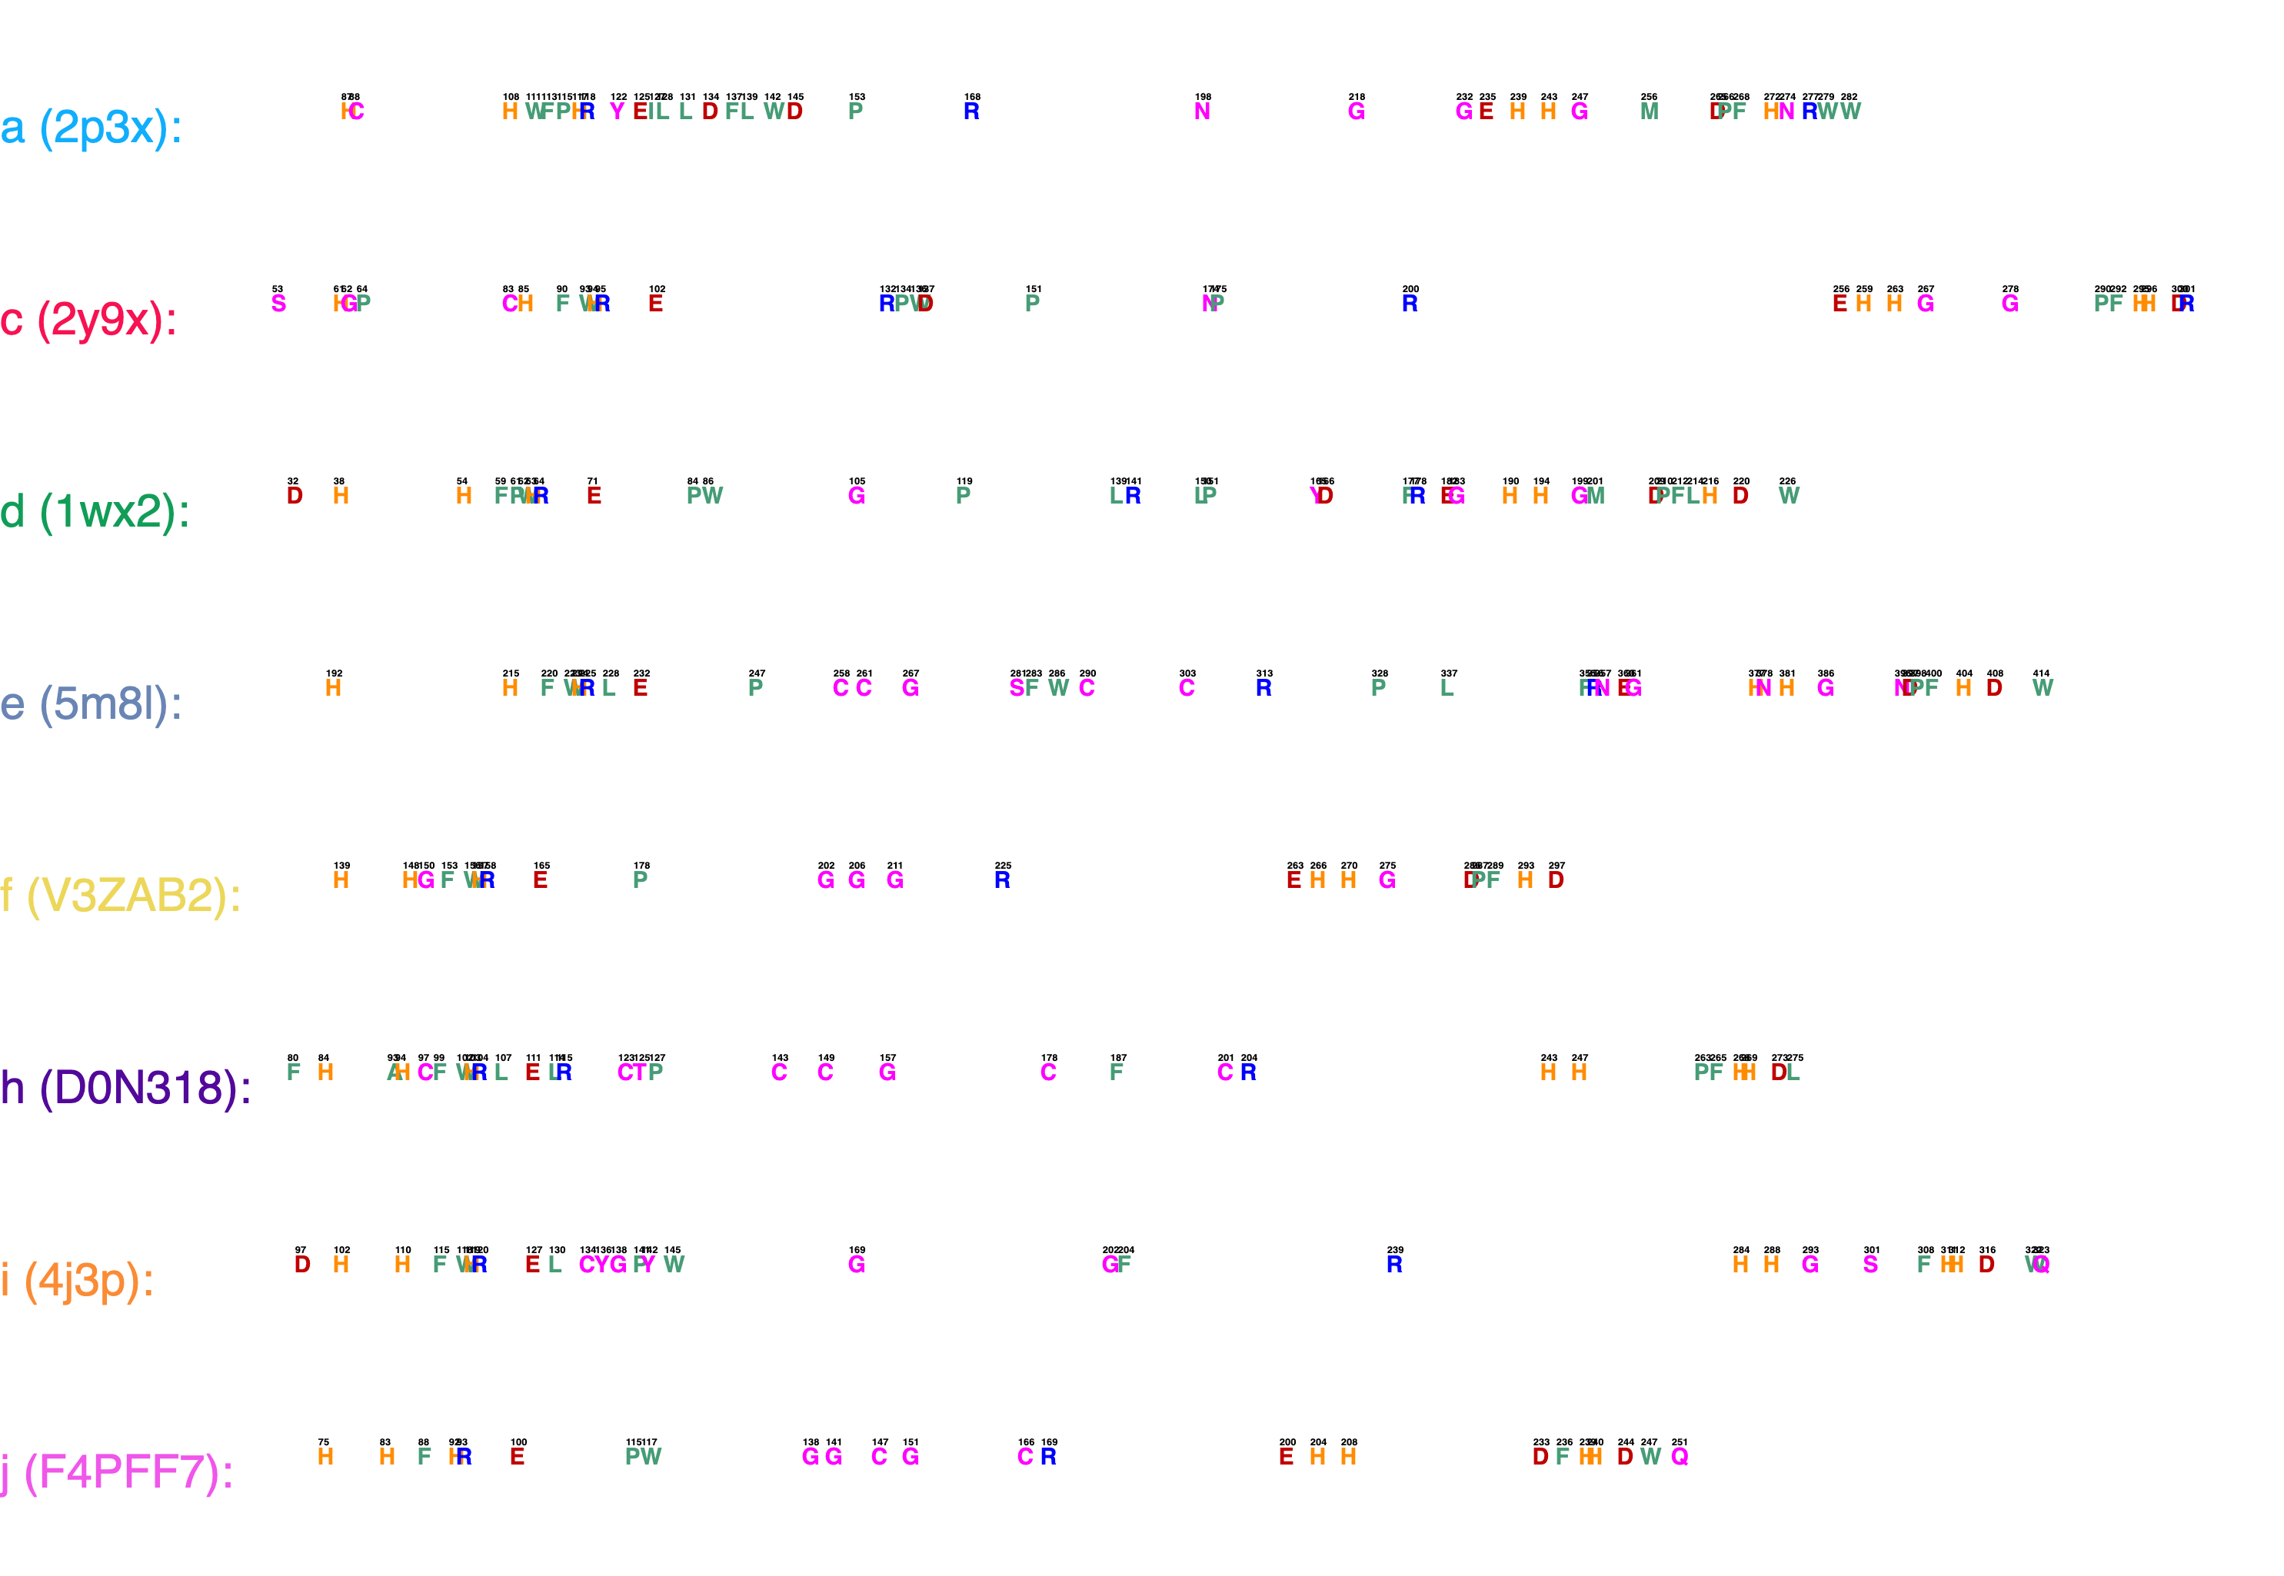
a
Cu_{A} binding motif
Cu_{B} binding motif
b

